Slide 1


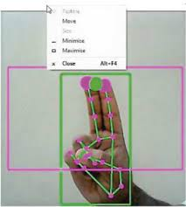
AI VIRTUAL MOUSE
TEAM MEMBERS :
Bipul Karna
Amit Kumar
Racha Yashwant

Slide 2
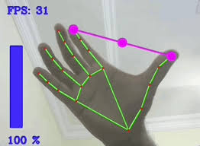
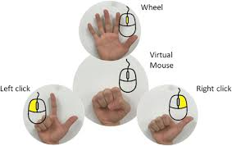
About the project:
The goal is to manage computers and others devices with gesture rather than pointing and clicking a mouse or touching a display directly.
In this project we use a approach that uses a video device to control the mouse system (Mouse tasks).

Slide 3
Project flow:
Find Hand Landmarks.
Get the tip of Index and middle fingers.
Check which finger are up.
Only Index finger up : Moving mouse
Convert Coordinates.
Smoothen Values.
Move Mouse.
Both Index and Middle fingers are up : Clicking mode.
Find distance between fingers.
Click mouse if distance are short. [distance to be specified]
Show frame rate.
Display the project i.e run virtual mouse.

Slide 4
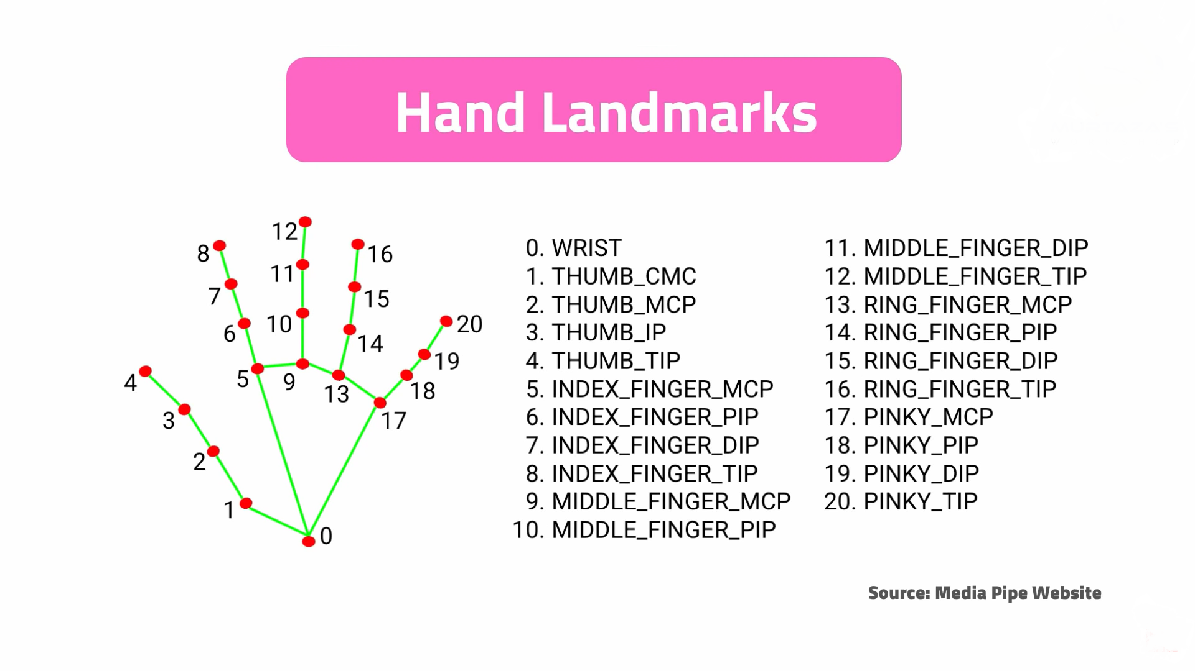
Hand landmarks
With the use of mediapipe python library we can detect face or hand landmarks based on our uses

Slide 5
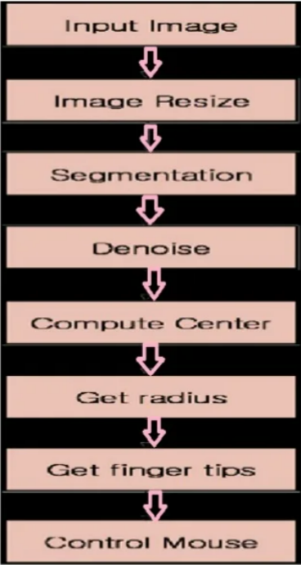
Project Approach
1. Image Resize :
Map camera coordinates to screen coordinates.
2. Segmentation :
Separate the hand area into RGB from a complex background.
3. Denoise:
Need to delete noisy pixels from the image.
4. Compute Center:
Draw a circle increasing the radius of the circle from the center coordinate until the circle meets the first black pixel.
When the algorithm finds first black pixel the it returns to the current radius.

Slide 6
5. Controlling Mouse:
Mouse movement -
When the algorithm detects only index finger up then mouse moves according to the speed of hand movement
Left click -
When there is index and middle finger both up and distance between them is significantly low then is left click

Slide 7
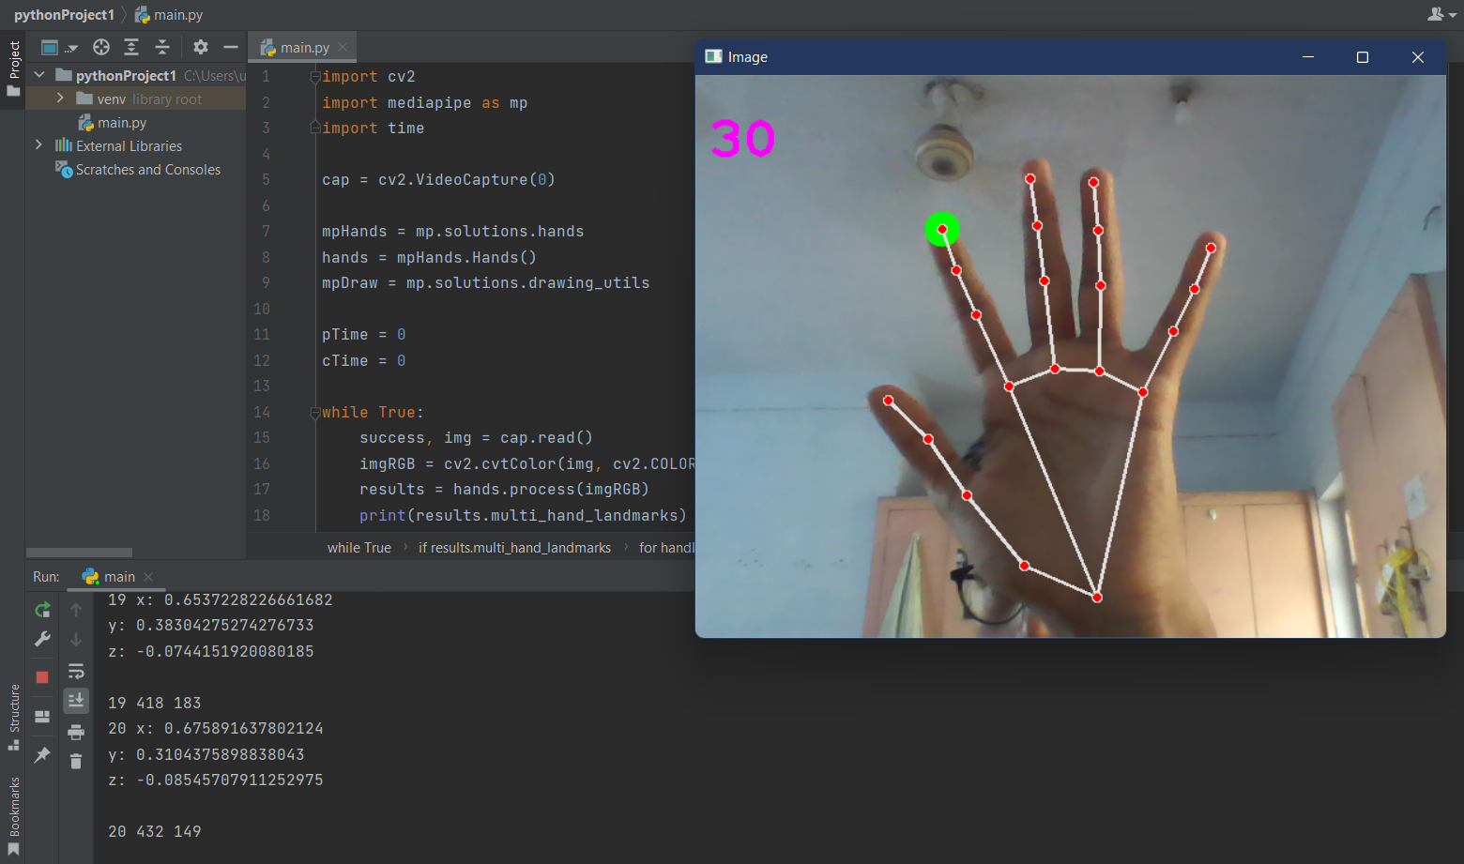
Hand tracking:

Slide 8
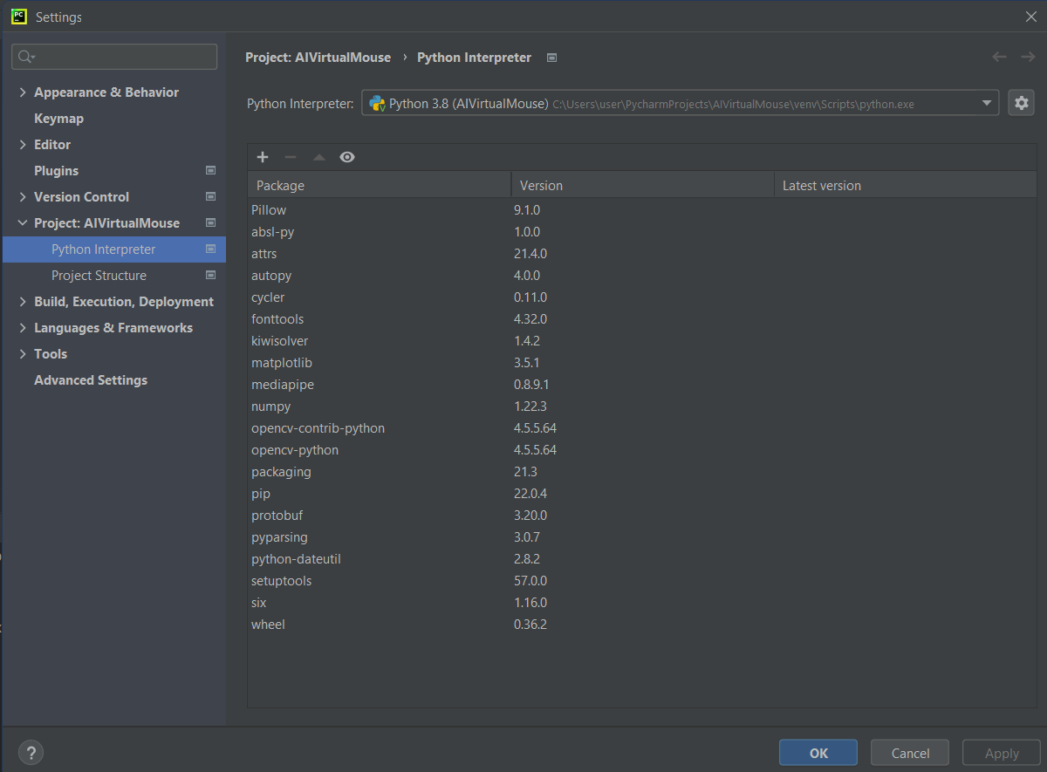
LIBRARIES used:

Slide 9
Hardware and software requirements
1. Webcam
cv2.VideoCapture(0) [For integrated Webcam]
cv2.VideoCapture(1) [For externally joined Webcam]
2. Required Libraries :
OpenCV [Open Source Computer Vision Library]: OpenCV library in python is a computer vision library that is widely used for image analysis, image processing, detection, recognition, etc.
Mediapipe : It is a cross-platform library developed by Google that provides amazing ready-to-use ML solutions for computer vision tasks.
AutoPy : AutoPy is a simple, cross-platform GUI automation library for Python. It includes functions for controlling the keyboard and mouse, finding colors and bitmaps on-screen, and displaying alerts.

Slide 10
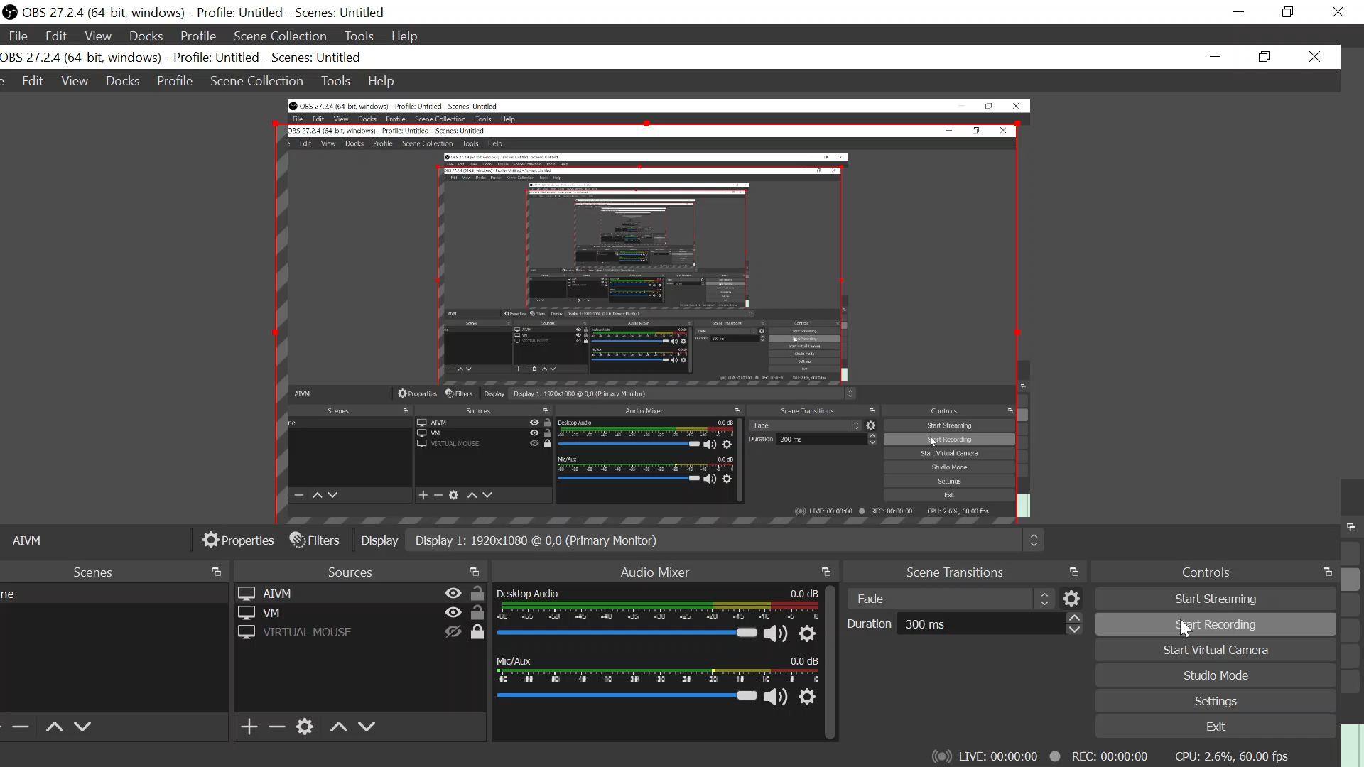

Slide 11
Future Scope
Further, we plan to add more features such as enlarging and shrinking windows, closing window, etc. by using the palm and multiple fingers.
We can also open the browser or any drives (C:/D:/E: etc) with help of hand gestures instead of moving of cursor.
This system could also be useful in presentations and to reduce work space.

